Slide 1
Introduction to Apache JMeter
Alan Gordon
June 2022

Slide 2
Agenda
JMeter Overview
JMeter Setup
Scenario Test Plan Configuration
Scripting Recording & Customization
Execution & Analysis

Slide 3


JMeter Overview

Slide 4

Key features (1/2)
Cross-platform:
JMeter can run on any operating system with Java
Distributed & scalable:
One master JMeter machine can control many hosts to generate high load
Multi-protocol support:
The following protocols are supported out-of-the-box: HTTP, SMTP, POP3, LDAP, JDBC, FTP, JMS, SOAP
Full multi-threading framework
JMeter allows concurrent and simultaneous execution of different functions by multiple threads
Test Result visualization:
Multiple built-in and external listeners to visualize and analyse performance test results
Test result can be display in a different format such as chart, table, tree and log file
Notes:
Distributed: When you need a higher load than a single machine can create, JMeter can execute in a distributed mode, meaning one master JMeter machine controls a number of remote hosts

Slide 5
Key features (2/2)
Easy Installation
Highly Extensible : Pluggable samplers allow unlimited testing capabilities.
Several load statistics may be chosen with pluggable timers.
Data analysis and visualization plugins allow great extensibility as well as personalization.
Functions can be used to provide dynamic input to a test or provide data manipulation.
Scriptable Samplers (BeanShell, BSF-compatible languages and JSR223-compatible languages)
Unlimited Testing Capabilities:
Manage application cookies and static requests caching
Various assertions to define criteria
Multiple implementations of pre- and post-processors around sampler: This provides advanced setup, teardown parametrization, and correlation capabilities
Easy integration to CI/DevOps process:
Integration with major build and CI systems, making JMeter performance tests part of the full software development life cycle
Notes:
Build/CI:
Jenkins, Maven plugins
Cmd line call from any tool

Slide 6
Advantages
Platform Independent
Scalable
Multi Protocol Support
Full Multi-threading Framework
Test Result Visualization
Easy Installation
Highly Extensible
Unlimited testing Capabilities
Easy Integration into CI

Slide 7
Comparison with other open source tools
Tool | Vendor | URL | Key Points | Enterprise Version Available?
JMeter | Apache | jmeter.apache.org | Java-based Easy to install GUI and non-GUI mode Large community and many plugins | Yes - via third party providers such as BlazeMeter or Octoperf (both cloud-based but offering on-premise options) Enterprise versions offer better setup and management of tests, run-time interface and reporting.
Gatling | Gatling Corp | gatling.io | Primary purpose was to be integrated with CI tools Scala-based Non-GUI mode only Web-only | Yes, enterprise version is called Gatling Frontline (cloud-based, on-premise option available). The enterprise version offers additional features such as integration with more build tools, management of tests, run-time interface and reporting.
Locust | n/a | locust.io | Python-based Web-based UI Highly scalable | No
k6 | LoadImpact | k6.io | JavaScript-based Developer-focused, aimed for CI integration | Cloud option (LoadImpact) available as SaaS
Notes:
Open source: Gatling, k6, Locust
Commercial: LoadRunner, NeoLoad, others

Slide 8
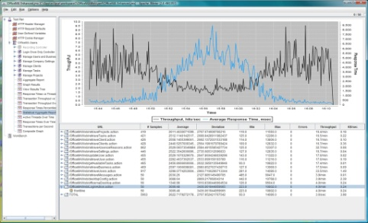
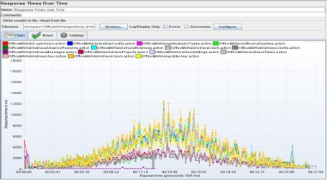
How does JMeter work?
JMeter simulates a group of users sending requests to the target application, and collects statistics on the responses
Send Requests to the target server
Check Server Responses and save them
Collect and calculate statistical info
Generate test report
JMeter Test Report

Slide 9
Installation & Setup

Slide 10
Setup (1)
Pre-requisites
Your PC:
JMeter Install file downloaded from https://jmeter.apache.org/download_jmeter.cgi
Java installed
Version 8 or higher
JDK preferred but JRE will work
Ensure JAVA_HOME and PATH are set correctly with the Java installation directory
Notes:
JDK better than JRE – need keytool utility for recording HTTPS
Not included in download:
JDBC drivers
JMS API jar
Many plugins

Slide 11
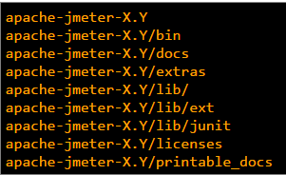
Setup (2)
Installation
Unzip the zip/tar file into target directory
(If needed) Provide permissions to run
Post-validation
The installation directory structure should look like this (where X.Y is version number)
bin – contains jmeter script for starting JMeter
lib – contains required Java libraries
lib/ext – contains core jar files
lib/junit – contains Junit library
Notes:
Mac – can install using homebrew – “brew install jmeter” or “brew install jmeter --with-plugins”

Slide 12
Running JMeter (1)
GUI MODE
This mode is mainly used to develop scripts and debug test scenarios
Run jmeter.bat (Windows) or jmeter (Unix) file from the bin directory
SERVER MODE
The server mode is mainly used for controlled distributed testing. It works as client-server model.
Run jmeter-server.bat
Notes:
To run tests on multiple machines, run the jmeter-server script on each of the load generator machines.
Then start jmeter on the “controller” machine using the option –r and it will connect automatically to the list of servers specified in remote servers file. Or use –R and specify the list of servers.
All servers will run the same test plan. You need to have any data files etc existing on the servers.

Slide 13
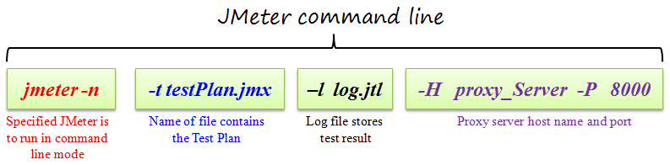
Running JMeter (2)
Command-line Mode
This mode is used for running higher load or when executing by script
Since JMeter in GUI mode consumes much computer memory, you may choose to run JMeter without the GUI

Slide 14


Slide 15
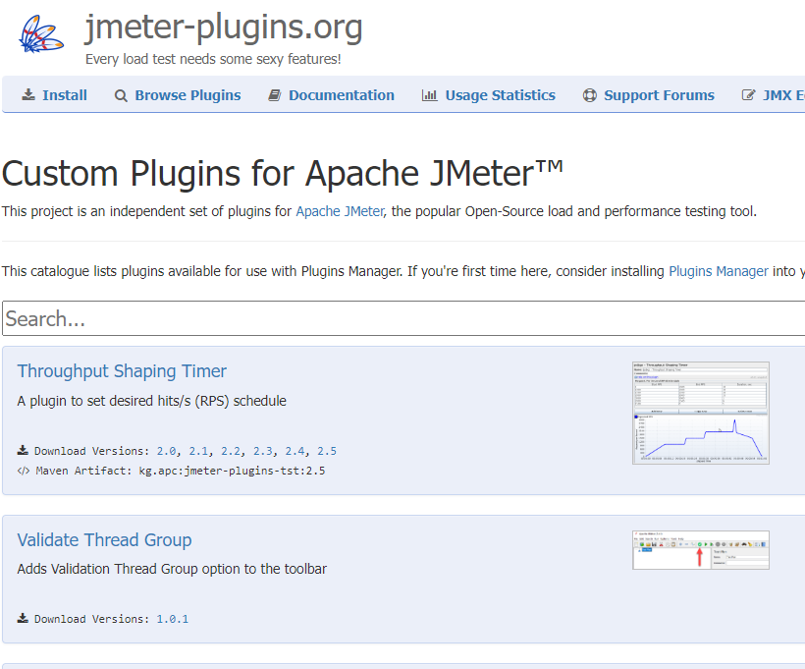
JMeter plugins
Essential for many features:
Additional graphs
Handle new protocols
Integration with other tools
Download & install Plugins Manager - https://jmeter-plugins.org/
Direct link: https://jmeter-plugins.org/get/
Copy the jar file to the JMeter lib/ext folder
Restart JMeter
Notes:
Example plugins:
Build tools such as Maven/Gradle
CI tools such as Team City, Jenkins
Integration with Selenium WebDriver, a common GUI automation tool, which enables running browser-based performance testing
Integration with Appium mobile test platform, for testing on real mobile devices
Hadoop, Cassandra database
Protocols such as MQTT
WS-Security calls for secure SOAP messages
Adobe Flex, GWT, Java serialization, video streaming (commercial, may require payment)
Citrix
Integration with APM tools
Code management tools like SonarQube (commercial, may require payment)

Slide 16
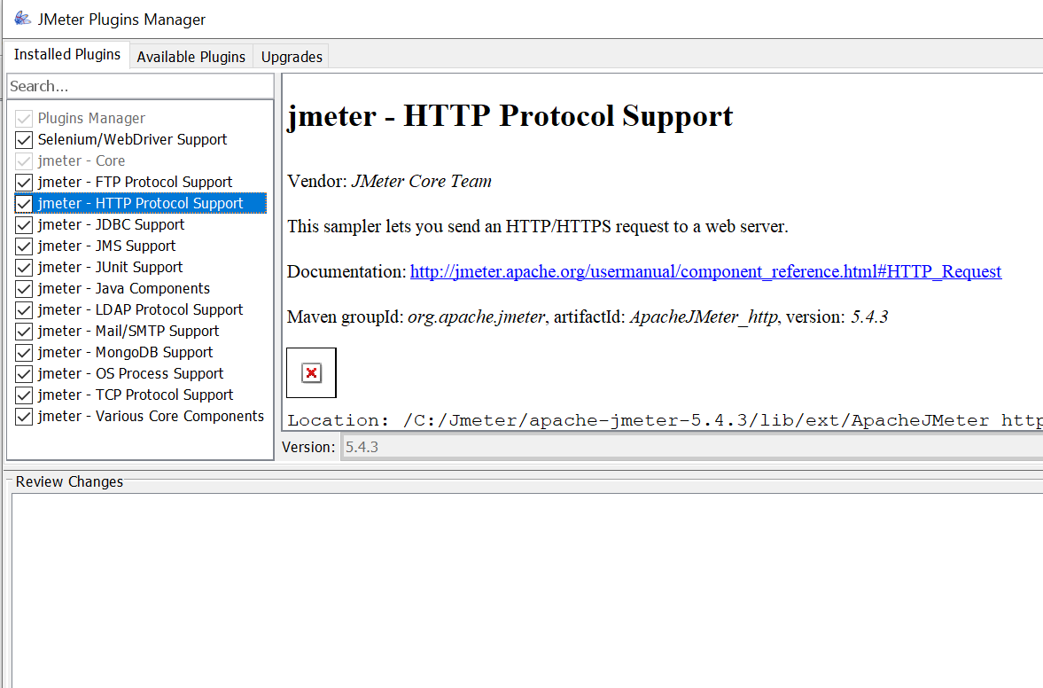
Plugins manager
Menu: Options / Plugins Manager
Installed
Available
Upgrades

Slide 17
Most useful plugins
Controllers & Thread Groups:
Custom Thread Groups
Weighted Switch Controller
Parallel controller & Sampler
Utilities:
Dummy Sampler
Throughput Shaping Timer
Random CSV data set
Listeners:
Graphs Generator Listener
(Various other options for graph generation)
Other Protocols/Samplers
Notes:
Customer thread groups:
Stepping Thread Group
Ultimate Thread Group
Concurrency Thread Group
Arrivals Thread Group
Free-Form Arrivals Thread Group
Graphs Generator Listener – generates numerous graphs incl. Active Threads over Time, Response Times/Time, Trx/Sec
3 Basic Graphs - Average Response Time, Active Threads, Successful/Failed Transactions
5 Additional Graphs – Response code, Throughput, Connect Times, Latency, Hits/sec
Graphs Generator Listener can also be used to generate graphs of a previously run test
Other protocols:
Citrix, HTTP2, etc

Slide 18
JMeter Key Features

Slide 19
JMeter script – key elements
Test Plan
Thread Groups
Samplers
Listeners
Timers
Assertions
Pre/Post Processors
JMeter Test Plan Element | Purpose
Thread Group | Define what the test looks like: Number of threads to be run Ramp up period No. of iterations, duration etc.
Sampler | Send requests or take some action
Controller | Logical control in script (loops, branches, random etc.)
Listener | Display results
Timer | Wait time – delay requests to make behaviour realistic
Assertion | Check the responses received from HTTP request to make sure the step passed
Configuration Element | Configure settings
Pre Processor | Execute some action before a sampler request
Post Processor | Execute some action after sampler request

Slide 20
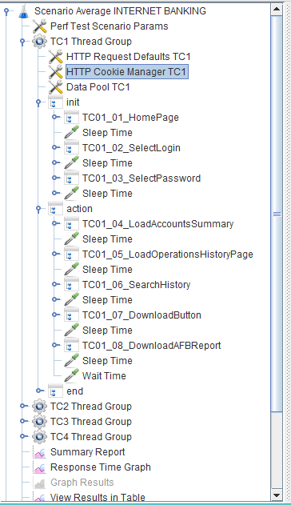
Test Plan = Test Scenario
CSV Data Set Config = Data pool
Runtime Controller = includes the steps that will be executed in run method
Thread group = Test Script
Simple Controller = includes the steps that are run once in init or end methods
Transaction Controller = Test Script Step Samplers are held inside
Listener = Result Reporting
Notes:
Test Plan is the overall file containing scripts & scenario.
Thread Group – test script - can have multiple (they are run concurrently by default)
Samplers – not visible in this screenshot because they are inside Transaction Controllers (more later)
Controller – e.g. Runtime, Simple, Transaction… - Flow Control/Logic/Grouping
Listener – for displaying results
Timer – e.g. sleep/wait time
Assertion – not visible in this example – inside Trx Controller
Configuration Element – e.g. data file setup
Pre Processor
Post Processor

Slide 21
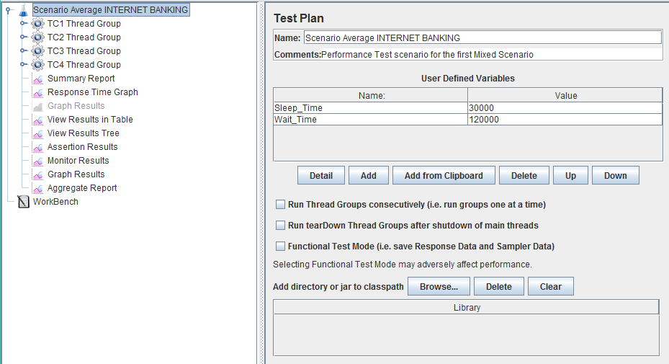
Test plan
Describes a series of steps JMeter will execute when run
Holds all the other elements

Slide 22
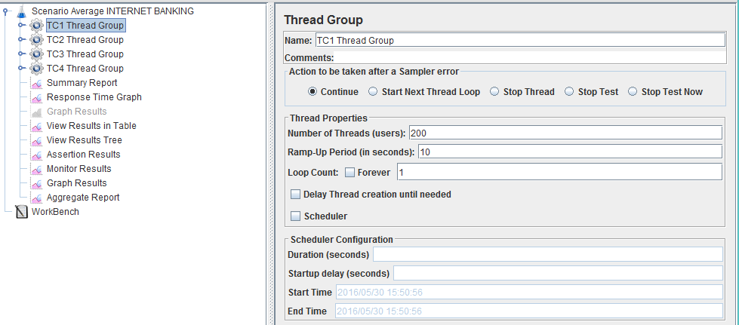
Thread group
Defines a group of users (threads) to be run in the test
Notes:
For example, if you set the number of threads as 100; JMeter will create and simulate 100 user requests to the server under test

Slide 23
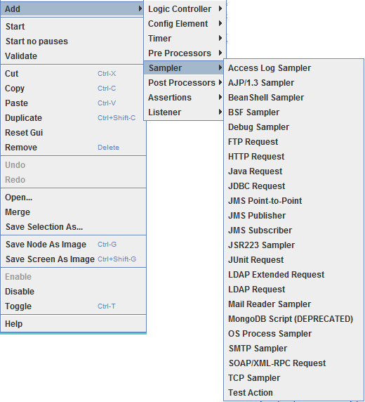
Sampler
Sends a request or takes some action

Slide 24
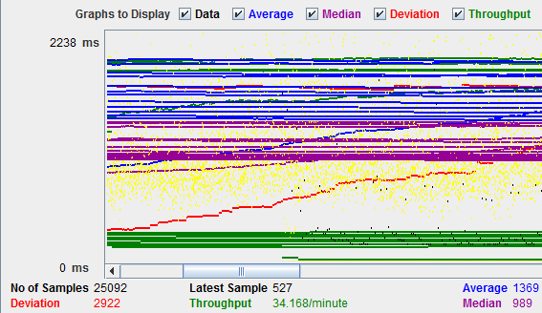
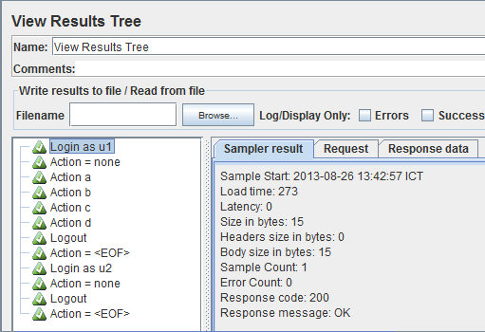
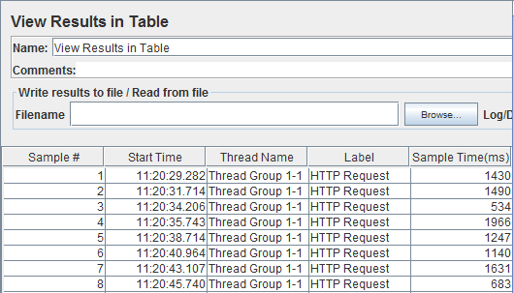
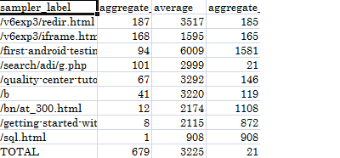
Listener
Displays results of an execution
Graph
Tree
Table
Log File
Notes:
Note: listeners can take up a lot of resources, so while they are great for building/debugging in GUI mode, best to disable them before running a higher load test.

Slide 25
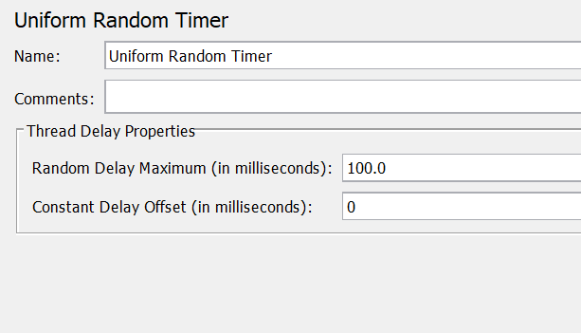
Timers
Adds delay/wait time to the thread
Different timers are available:
Constant
Random
Scripted (BeanShell, JSR223)
Throughput-based
Notes:
Scope of timers – if added in the top level it will affect every request in the whole script.
Better to add under a transaction controller.

Slide 26
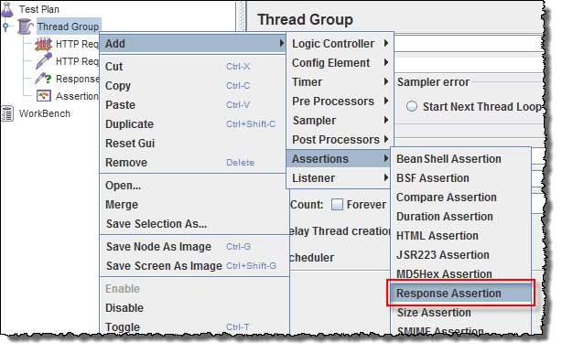
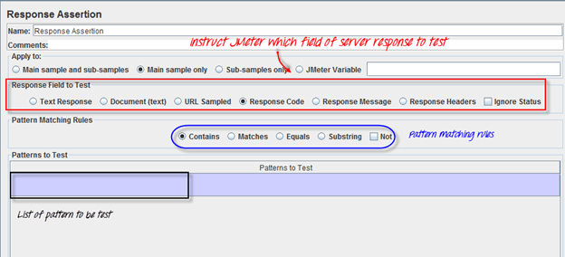
Assertion
Assertions help verify that the response is as expected
Common assertions in JMeter:
Most Useful: Response Assertion
Matches: XMLPath, JSON
Qualities: Duration / Size
Format: XML / JSON / HTML
Coded: JSR223 / BeanShell

Slide 27
Controller
Controllers determine the order in which actions are executed
Logic Controller Types | Description
Simple Controller | Simple Controller is just a container for grouping user requests
Runtime Controller | Controls how long its children are allowed to run
Transaction Controller | Measures the overall time taken to finish multiple test steps
Loop Controller | Makes the steps run a number of times (or forever)
Random Controller | Makes all the user requests run in random order each time
Include Controller | Designed to use an external test plan. This controller allows you to use multiple test plans in JMeter
Notes:
Simple (grouping)
Transaction (grouping for response times)
If
While
Runtime – run for a fixed time
Interleave – only run one of the sub-requests, different one each time
Random – run in random order

Slide 28
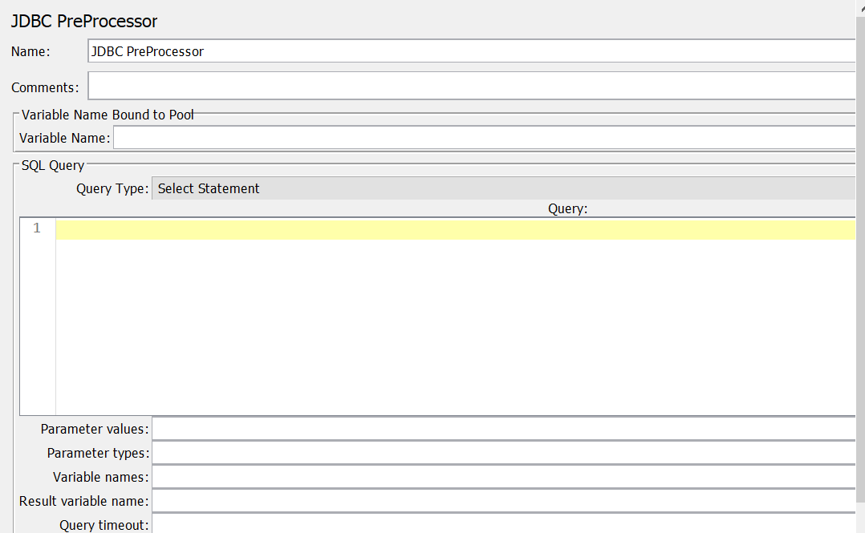
Pre-Processor
Pre-Processor is used to do some action before sending a request
Examples:
User Parameter
JSR223 / BeanShell
JDBC Query
Notes:
Typical examples of why to use a coding pre-processor:
Build a string or do some calculation to produce a variable to be used in the next request
Check state before deciding whether to run the next step or not
Debugging – write to log

Slide 29
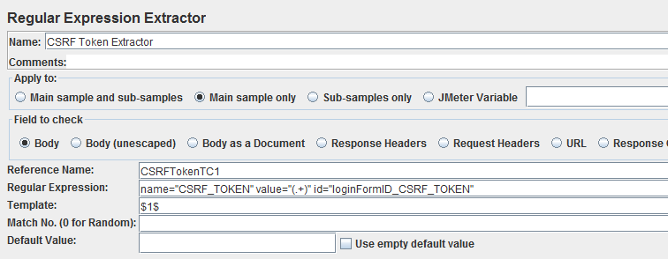
Post-Processor
Post-Processor is used to take some action after making a request
There are several types of post-processor:
Extractor - JSON/ XPath/ CSS / Regex
Regular Expression Extractor is used to extract a string from the response (typically to make a script correlation)
Coded – JSR223 / BeanShell
Script Flow – Debug, Action

Slide 30
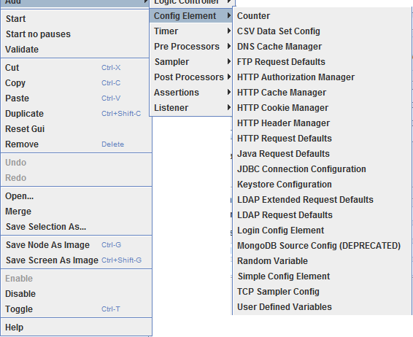
Configuration elements
Set up defaults and variables for later use by samplers
HTTP Default Request: element that sets default values that your HTTP Request controllers use.
HTTP Cookie Manager: automatically stores cookie and uses it for all future requests to that particular web site.
HTTP Cache Manager: element that manages the static resources cached
CSV Data Set Config: element that allows you to read different parameters from that text file

Slide 31
Scripting Demo

Slide 32
Scripting Process
Define the user flow to be scripted & practice it
Record steps (directly in JMeter or as HAR file)
Correlate dynamic data
Add parameter data
Add assertions
Add timers
Replay script with single user (same/different)

Slide 33
Discussion / Questions?

